Slide 1
ECE ILLINOIS
Dr. Karl Reinhard
Power System Dynamic Modeling Notes
1 Feb 2018
Notes:
ECE Main Slide

Slide 2
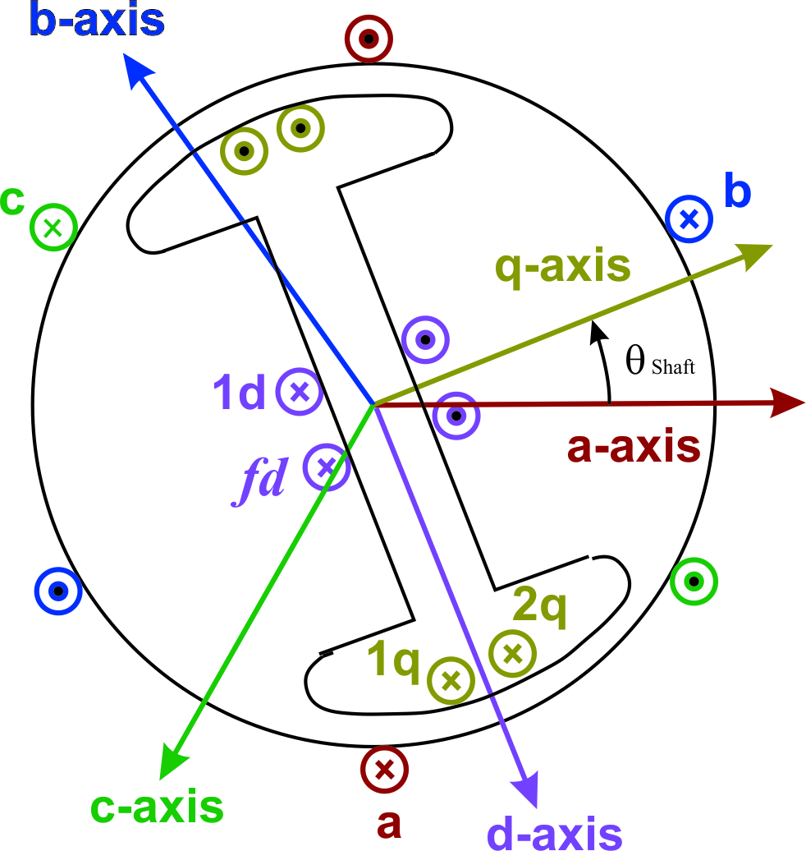
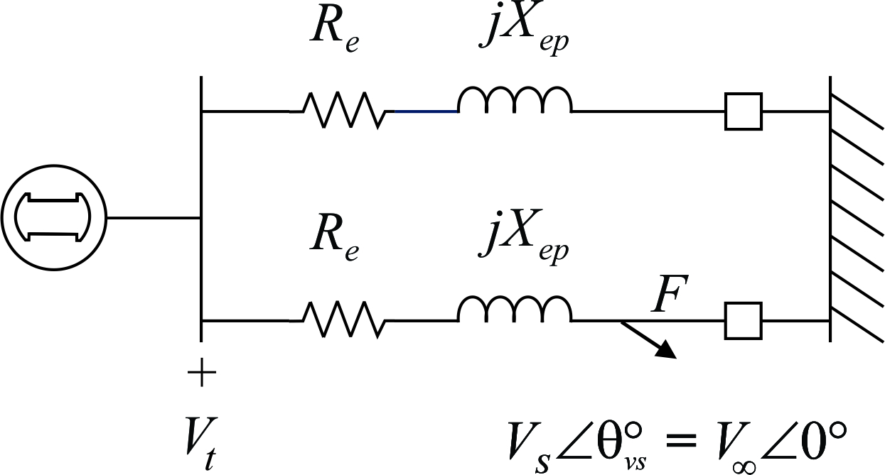
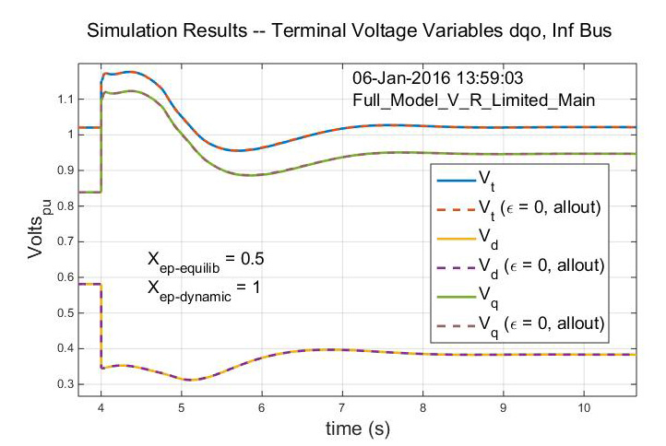

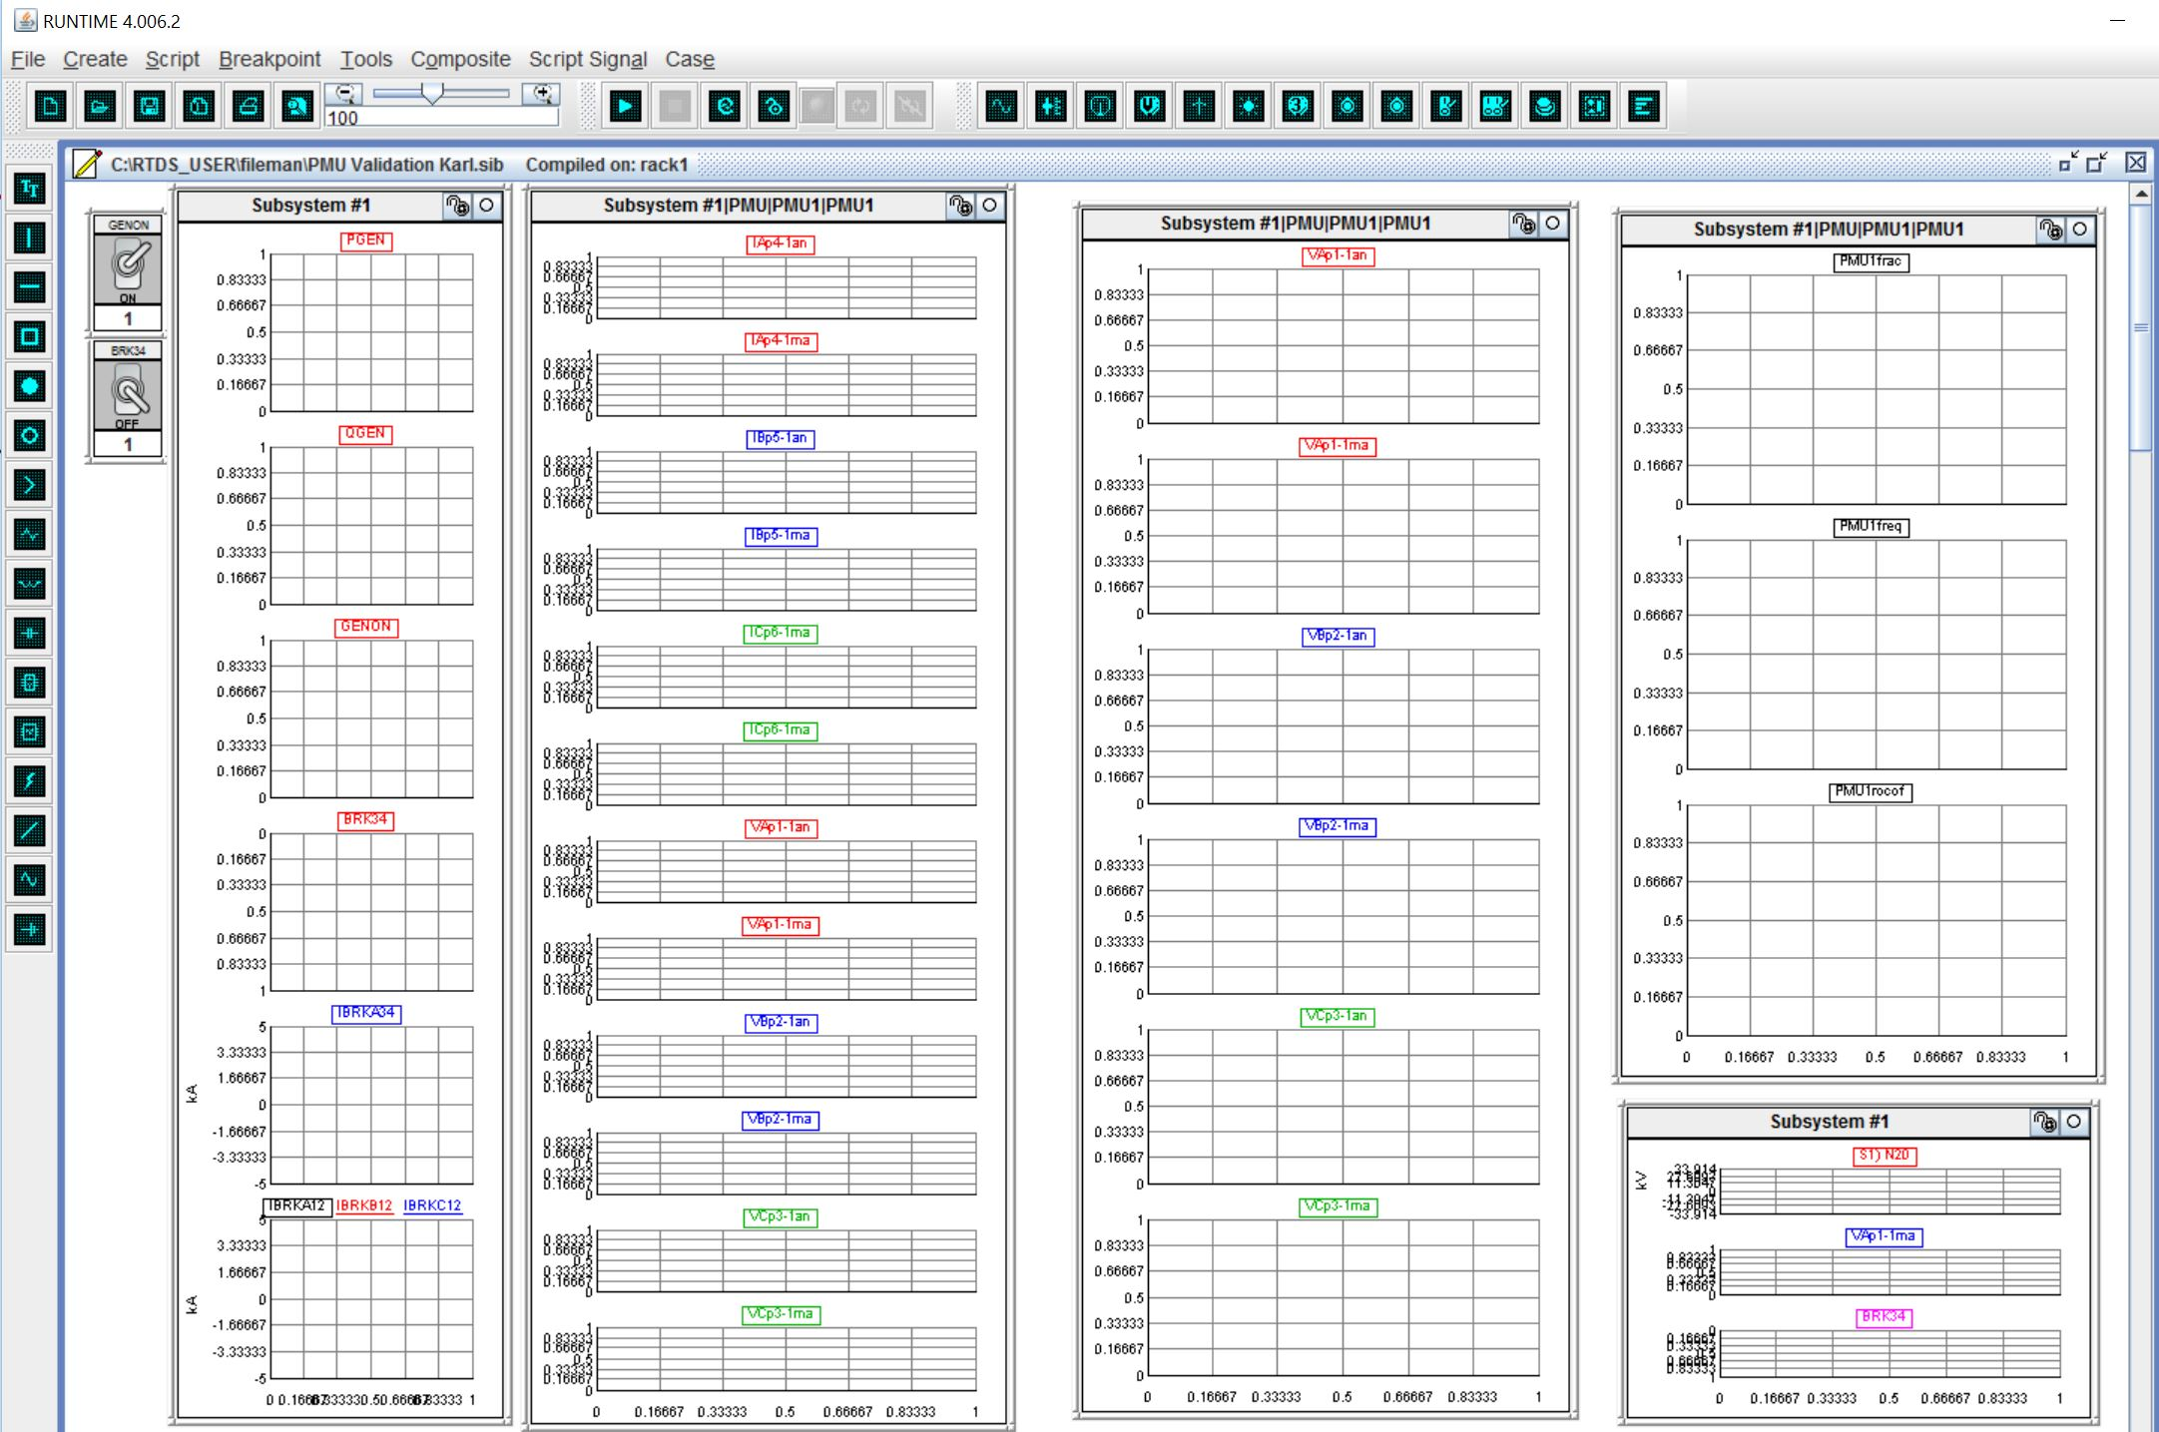
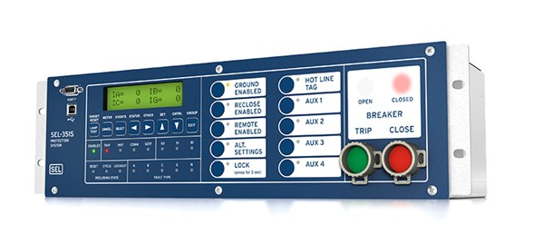
Details – SynchroPhasors Applied to Synchronous Machines
Synchronous Machine Dynamic Model Simulation
RTDS Simulation with Commercial PMU
Synchronous Machine Dynamics from SynchroPhasor Data ??

Slide 3
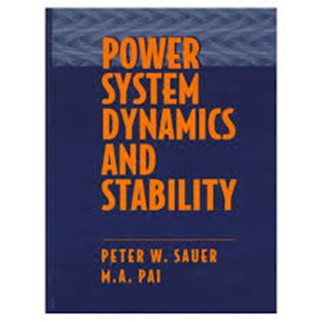
Dynamic Phenomena Time Scales

Slide 4
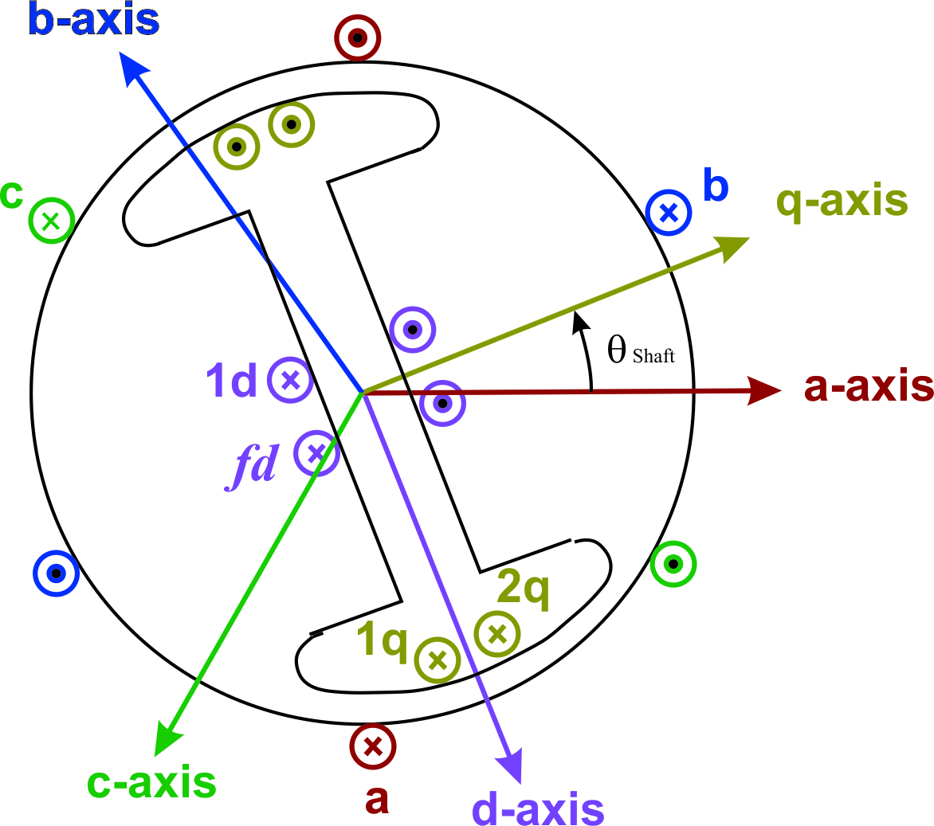
Synchronous Machine
Rotor
Stator

Slide 5

Synchronous Machine
Rotor
Stator

Slide 6
Power Engineering: Load “sign” Convention
(aka “Passive sign convention”)
LOAD SIGN CONVENTION
i (t) into load is ‘+’
p (t) into is ‘+’
v (t) is ‘+’ across load (from entry to exit terminals)
→ Load is absorbing Power (i.e. resistor radiating heat)
Detailed sign convention discussion:
https://en.wikipedia.org/wiki/Passive_sign_convention
The Load Sign Convention and Kirchoff’s Laws must
be applied with signs consist with & satisfying:

Slide 7
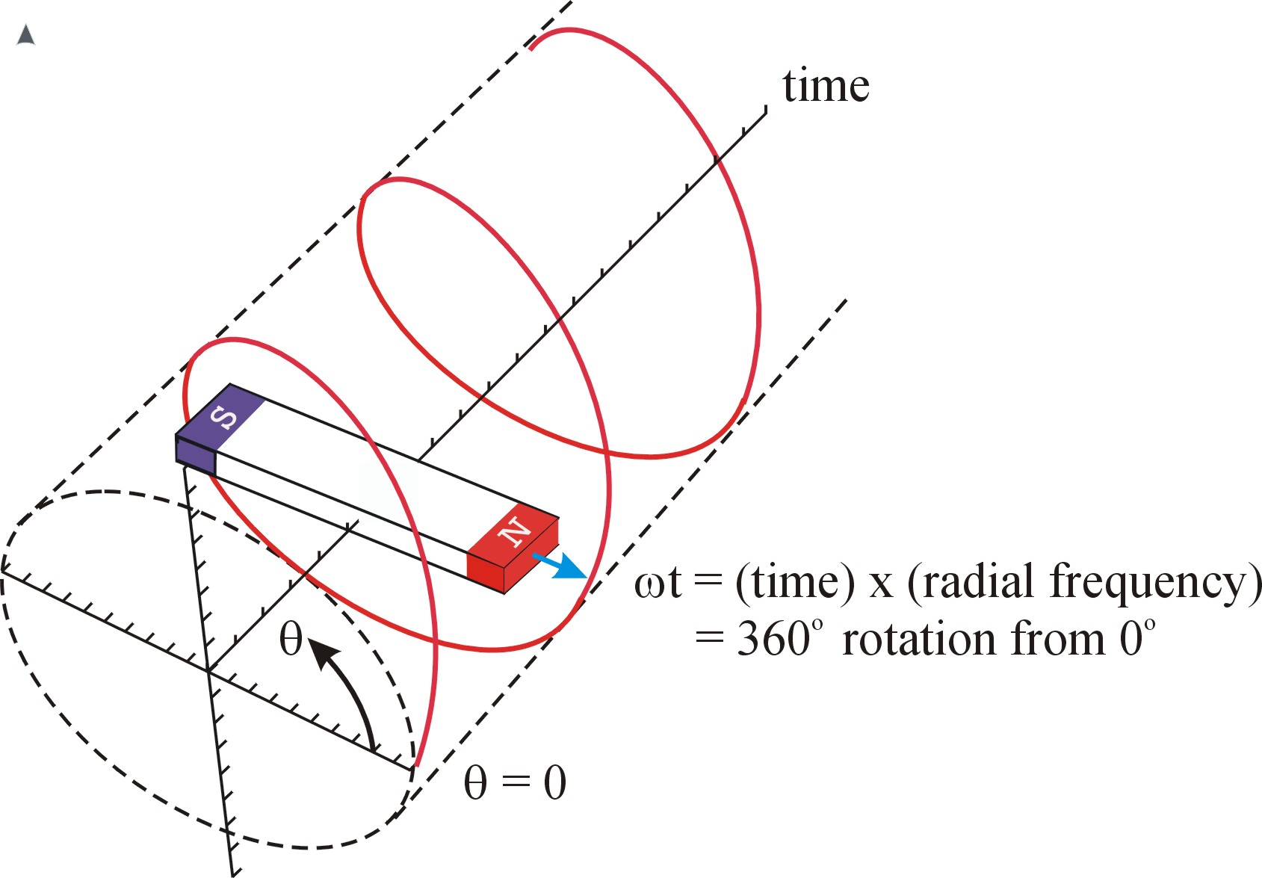
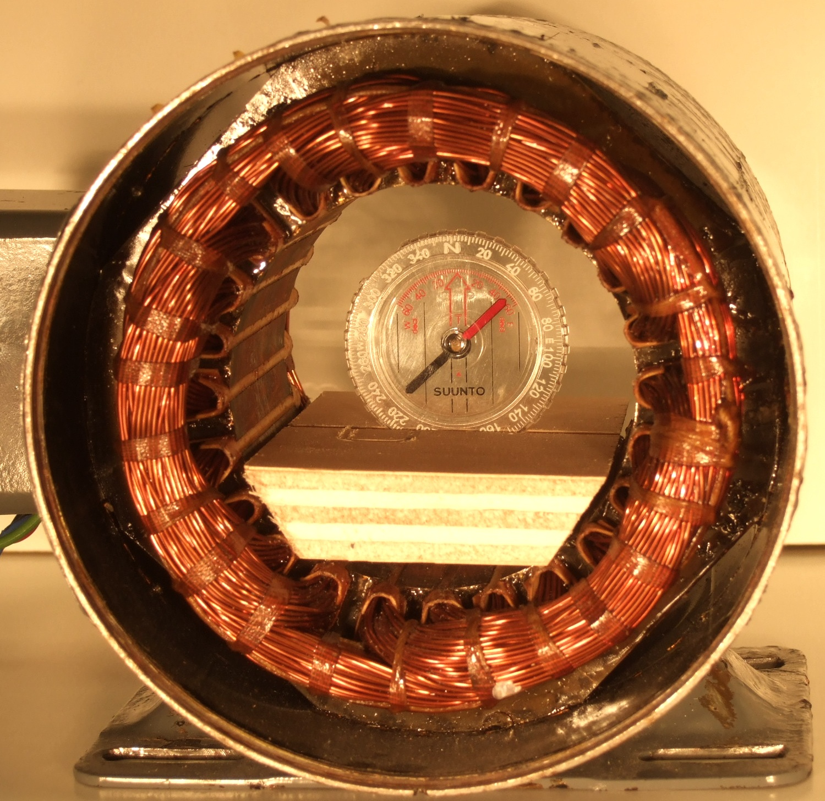
THE ROTATING MAGNETIC FIELD… ENABLING ROTATING MACHINES
Superimposing three time-varying magnetic fields results in a single magnetic field that rotates with time.
The rotating magnetic field is created by applying
3 sinusoidal voltages time-shifted by 1/3 of a cycle (120º) to
3 coils positioned 120º apart about the machine axis
THREE 1/3 CYCLE TIME-SHIFTED
VOLTAGES
THREE 120º SPACE-SHIFTED
COILS

Slide 8
MATLAB Application
Solver ODE solver – ode15s
  Stiff Differential-Algebraic Equations; variable time-step
  variable order method
Mass_Vector = [ T_s; %( 9)2*H/(2*pi*60)
T_qoprime; %( 6)T_qoprime
T_qo2prime; %( 7)T_qo2prime
T_A; %(12)T_A
0.0; %(18)Algebraic Eqn (V_t)
0.0; %(19)Algebraic Eqn (V_d)
0.0 %(20)Algebraic Eqn (V_q)
T_doprime; %( 4)T_doprime
T_do2prime; %( 5)T_do2prime
0.0; %( 2)Reduced Sys Alg Eqn
0.0; %( 1)Reduced Sys Alg Eqn
0.0; %(15)Algebraic Eqn (I_d)
0.0; %(16)Algebraic Eqn (I_q)…
% Full Model
options = odeset('Mass‘,Mass_Matrix,
MaxOrder',5,'MaxStep',.002);
[Full_Mdl_Soln] = ode15s(@Full_Model,
tspan,Init_Cond,options);

Slide 9
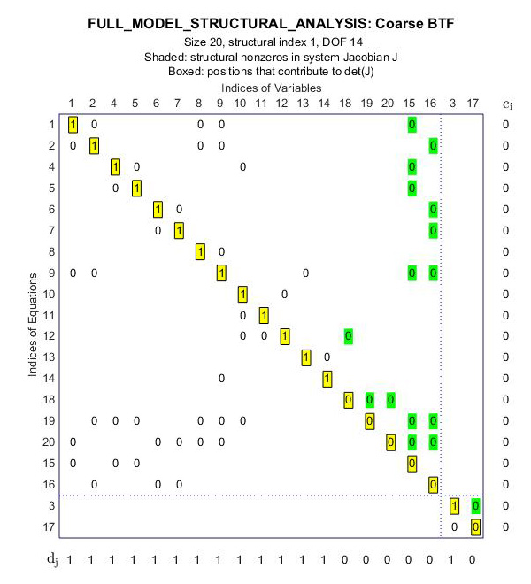
MATLAB’s DAE Structural Analysis Tool
MATLAB’s DAESA Tool
  Differential-Algebraic Equations Structural Analyzer,
  Determines structural index, number of degrees of freedom, constraints, variables to be initialized, and suggests a solution scheme.
MATLAB’s DAESA Tool
  Structural index
  # degrees of freedom
  Constraints
  Variables to be initialized,
  Suggests solution scheme.

Slide 10
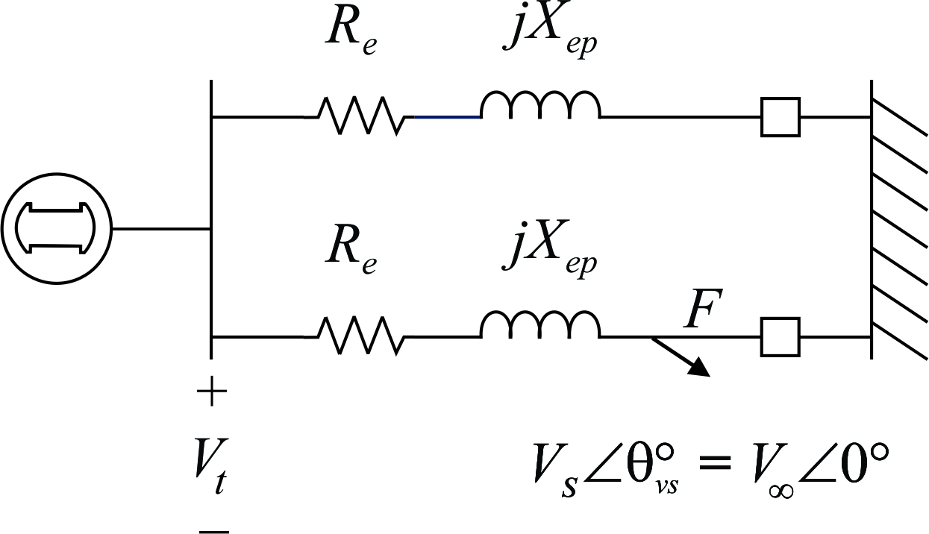
3 Fast Dynamic States

Slide 11
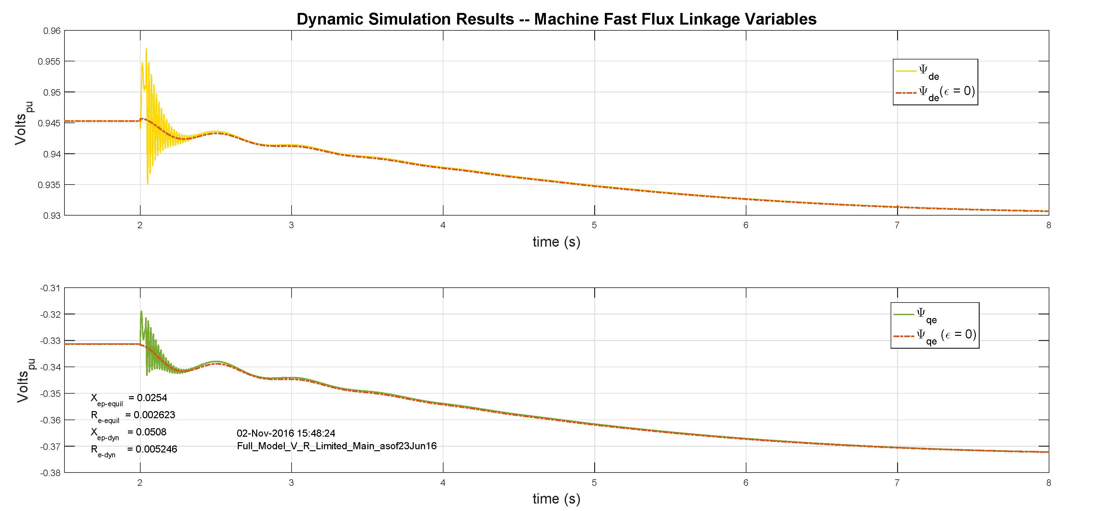
Machine Flux Linkage Dynamic Response

Slide 12


11 not so fast Dynamic States (1/2)
Synchronous Generator

Slide 13
11 not so fast Dynamic States (2/2)
Excitation System
(Terminal Voltage Control)
Main Exciter
Stabilizing Transformer
Pilot Exciter
Mechanical Power System
(Shaft Speed Control)
Single Stage Turbine Model
Governor Model
P_{SV} = Steam Valve Psn ( Pressure)
P_{C} = Power change setting
P_{C} = 0 when Open Ckt
R_{D} = Speed Droop Regulation Qty

Slide 14
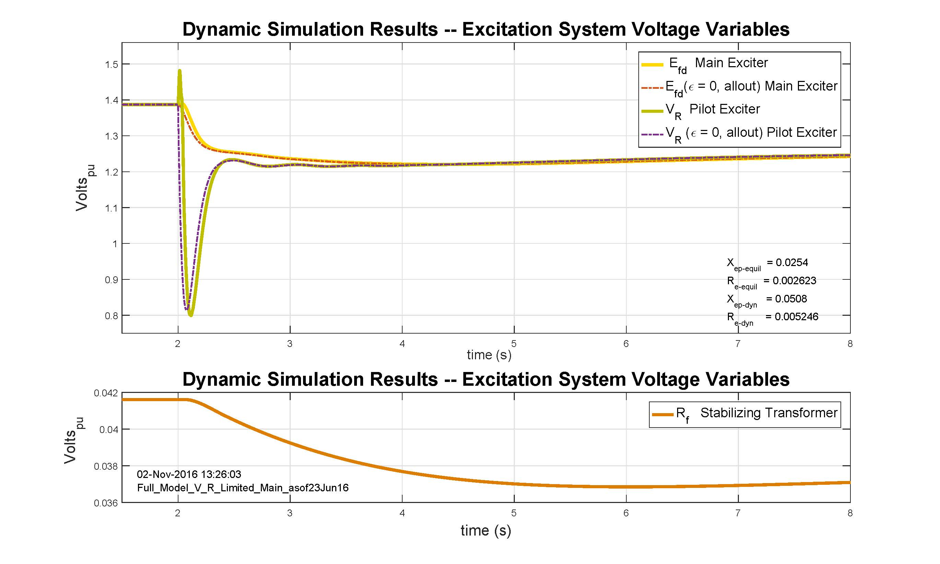
Excitation System Dynamic Response

Slide 15
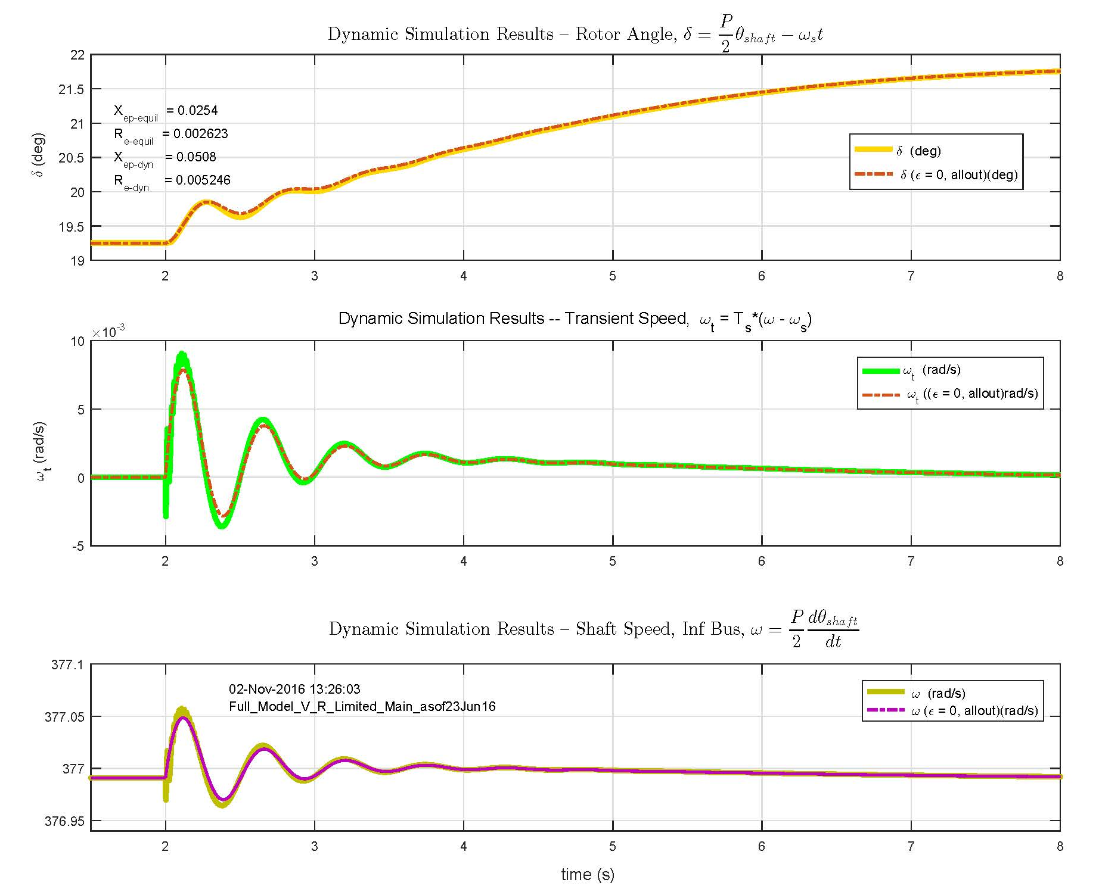
Mechanical Dynamic Response

Slide 16
Algebraic Equations (2/2)
6 Algebraic States
(15)
(16)
(17)
(18)
(19)
(20)
3/13/2018

Slide 17
Algebraic Equations (2/2)
(19)
(20)
ε
Many places on DAE Sys RHS – How to Address in Reduction to 2-Axis Model ??

Slide 18
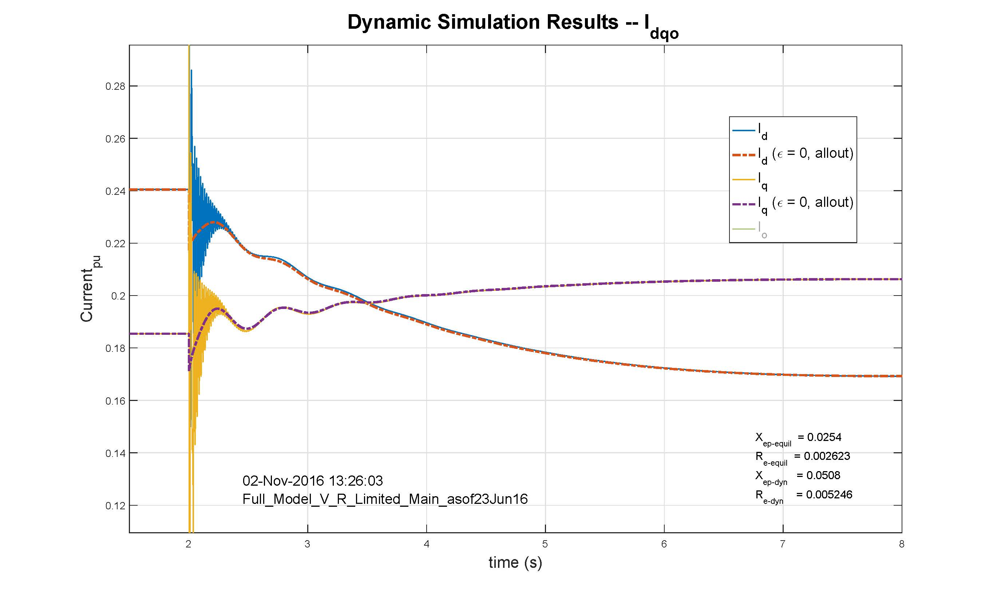
Terminal Current Dynamic Response

Slide 19
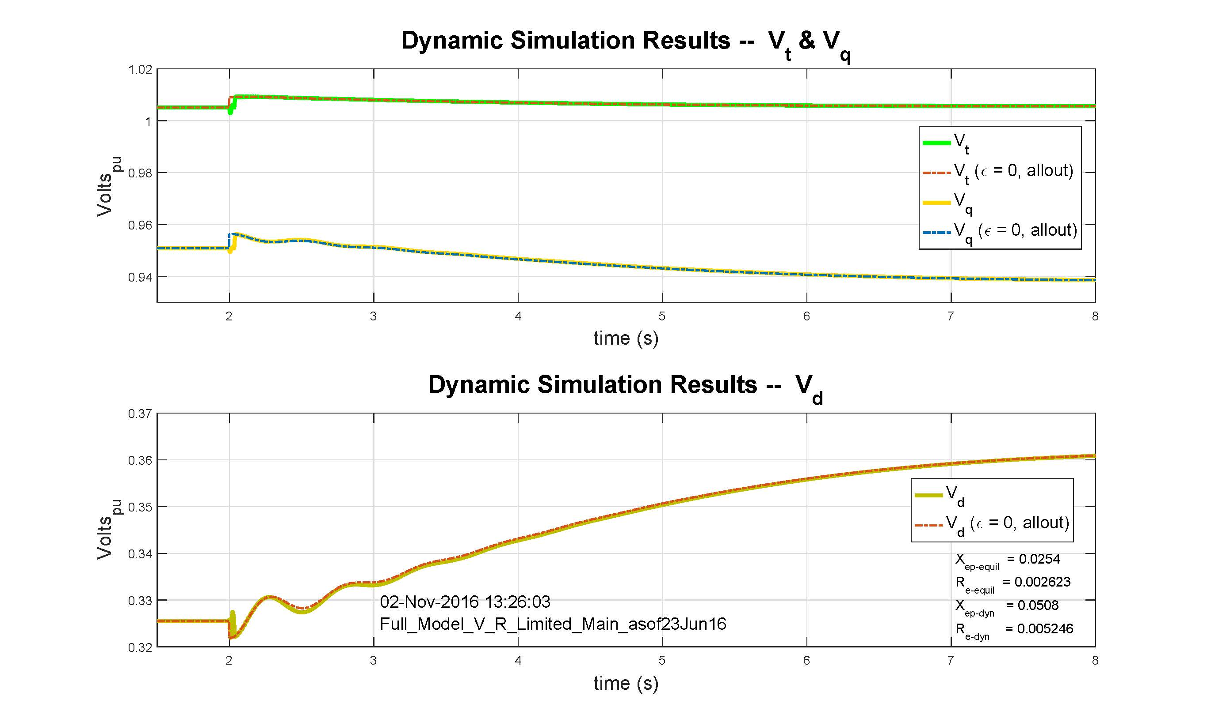
Terminal Voltage Dynamic Response – dqo

Slide 20
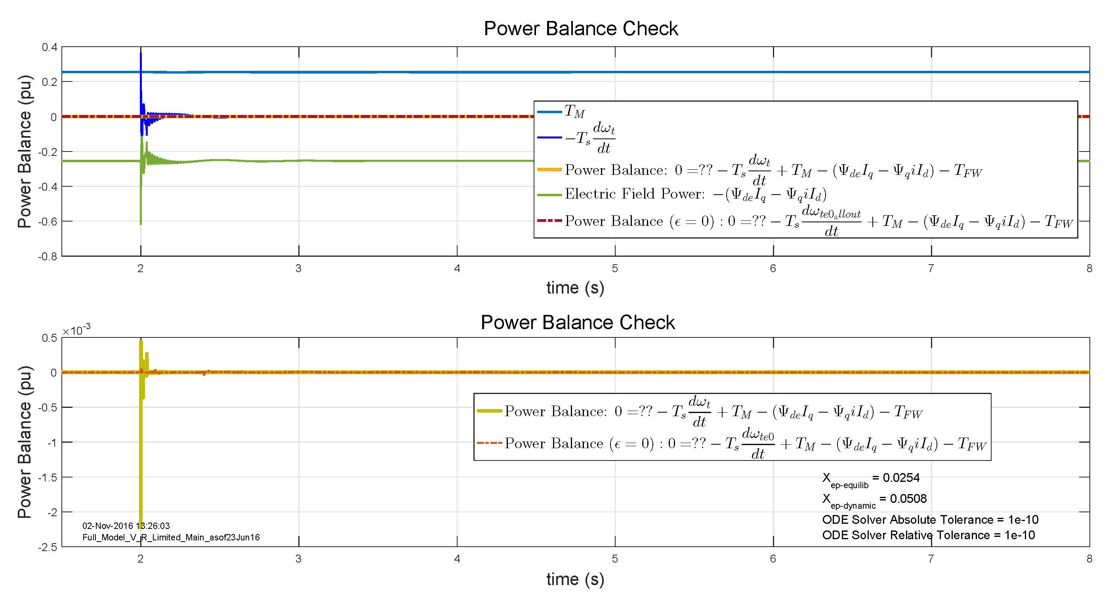
Solution Check –

Slide 21
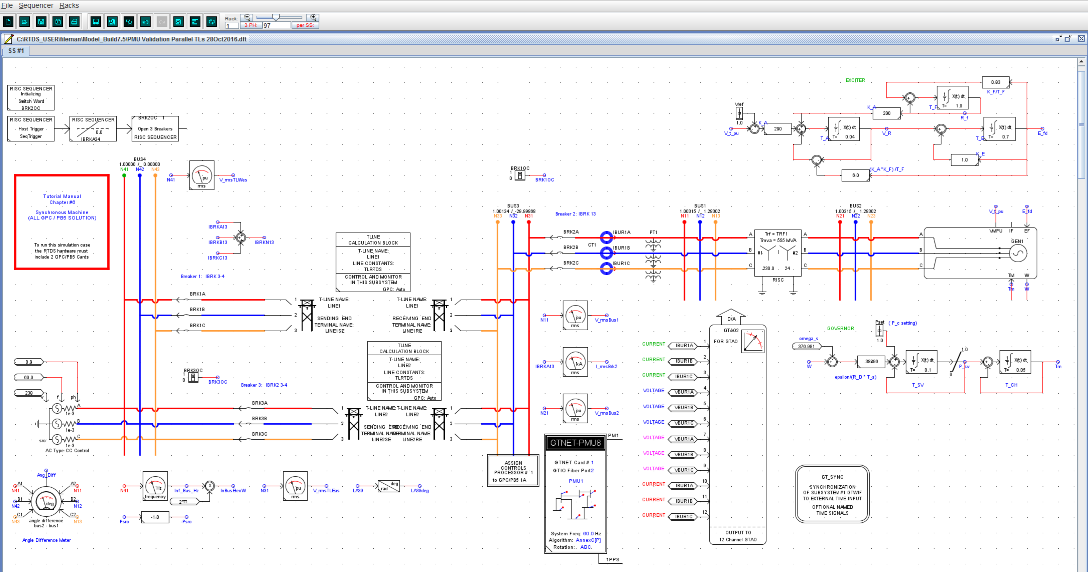
RTDS Model Development Interface

Slide 22
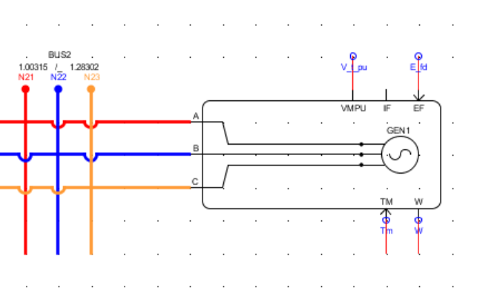
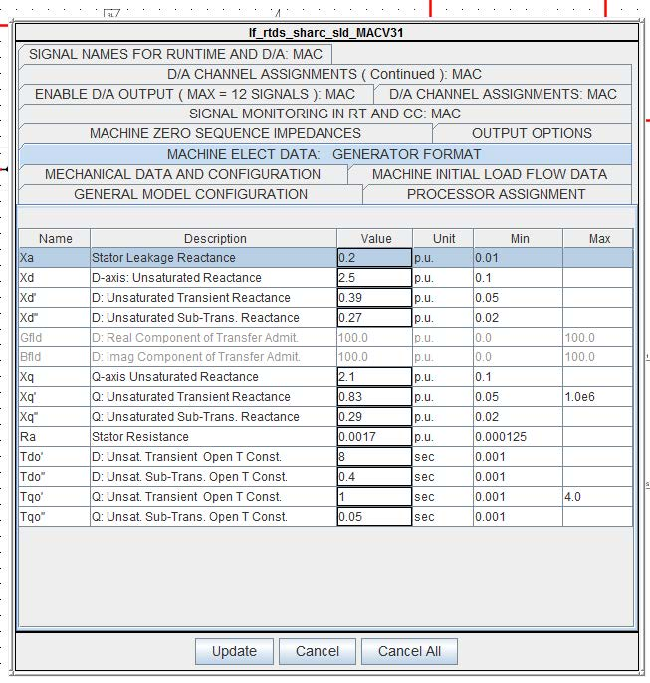
RTDS Synchronous Generator

Slide 23
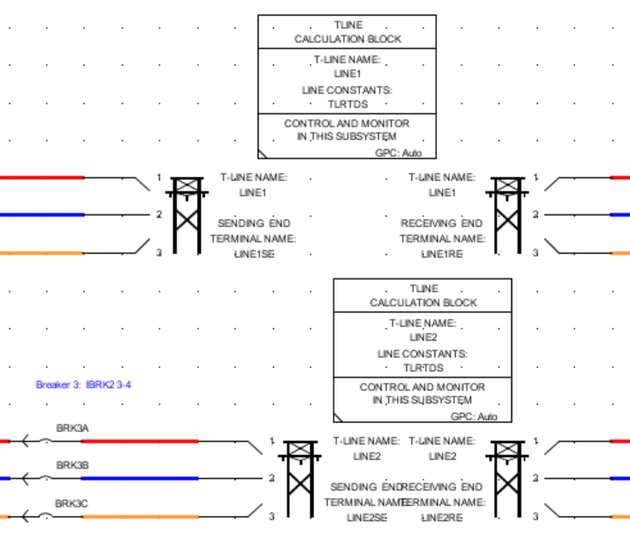
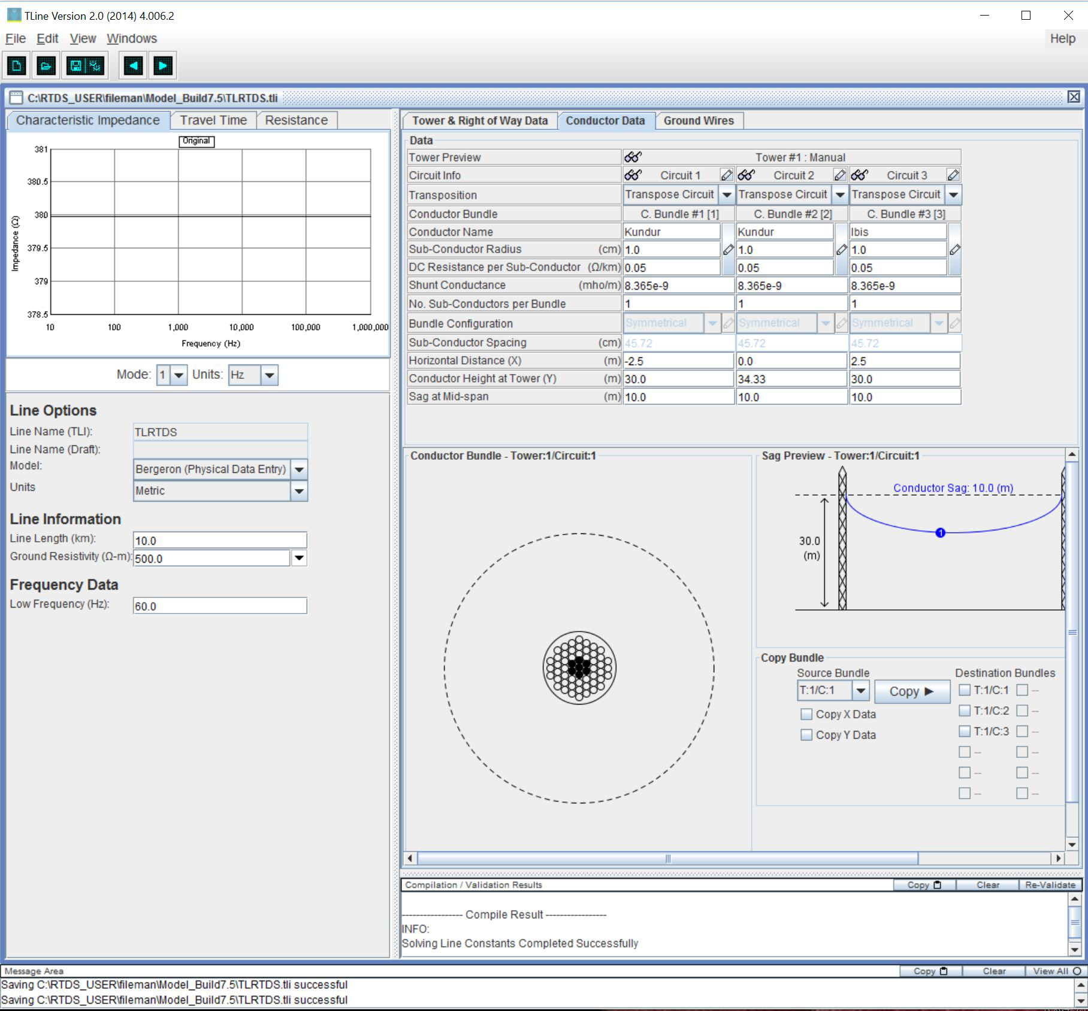
RTDS Transmission Line Model
Z @ 10 km | [pu] | Z_base =
 |  | 9.531E+01
R:
1.154E-02 | 6.077E-03 | 6.088E-03
6.075E-03 | 1.152E-02 | 6.077E-03
6.088E-03 | 6.077E-03 | 1.154E-02
X:
9.880E-02 | 4.775E-02 | 4.774E-02
4.775E-02 | 9.883E-02 | 4.775E-02
4.775E-02 | 4.775E-02 | 9.880E-02
L:
2.50E-02 | 1.21E-02 | 1.21E-02
1.21E-02 | 2.50E-02 | 1.21E-02
1.21E-02 | 1.21E-02 | 2.50E-02
(Kundur Table 6.1, 10km)
Surge Impedance Load – 140 MW
Z_{c} = 380 Ω

Slide 24
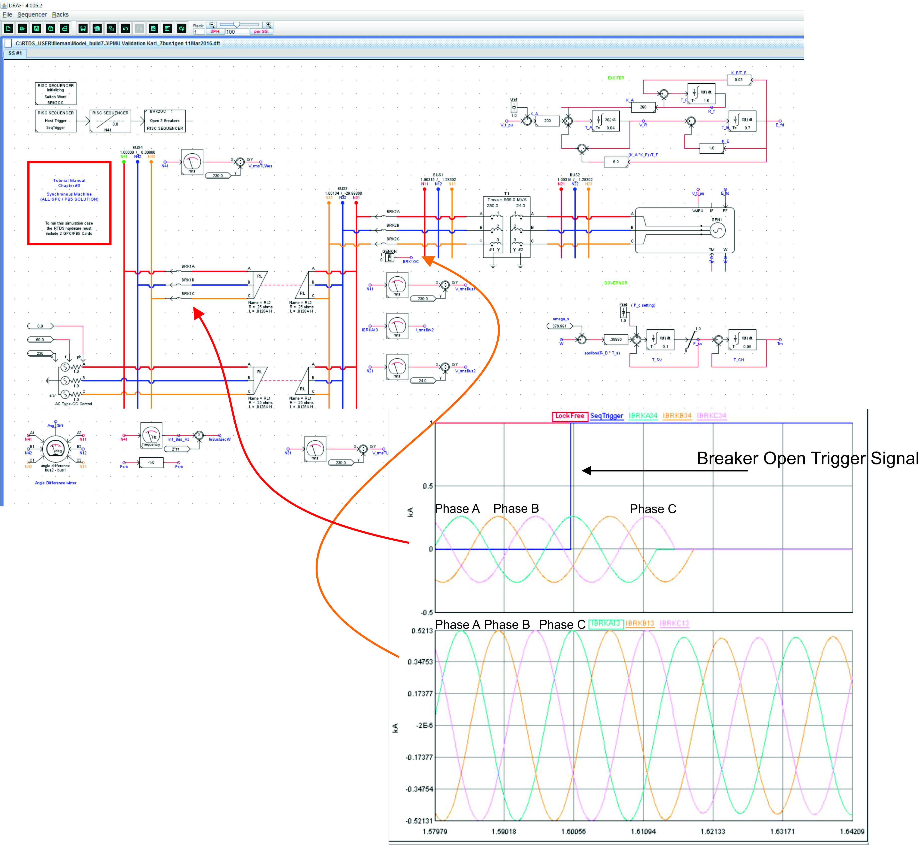
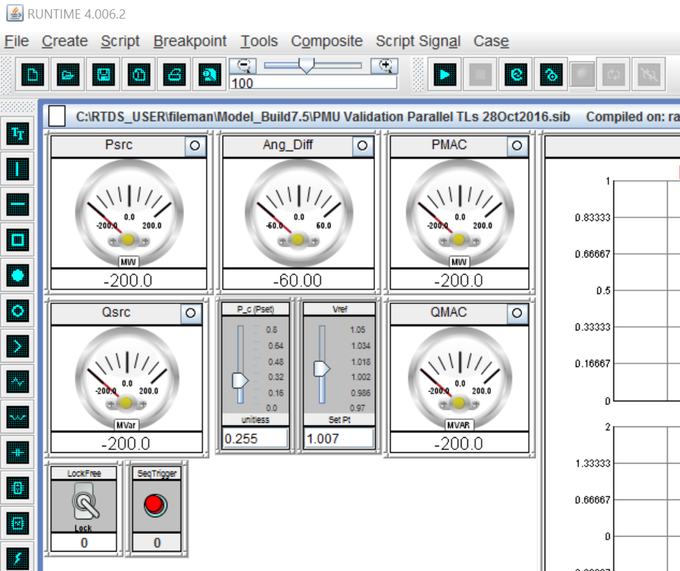

Slide 25
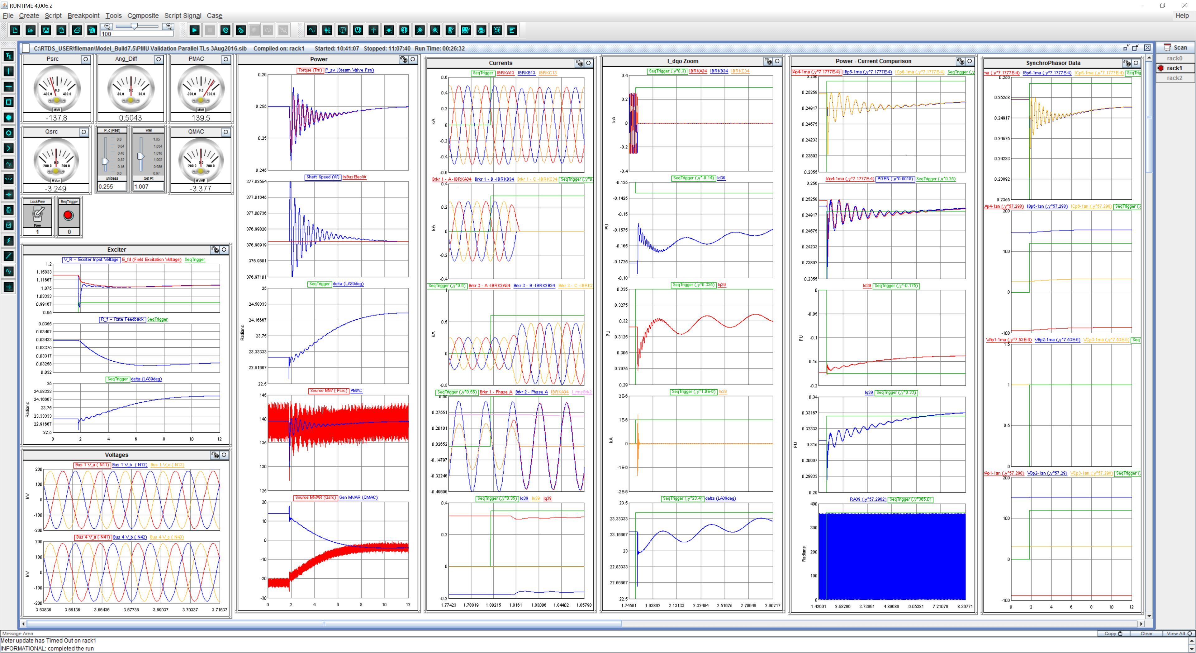
RTDS Control and Simulation Interface

Slide 26
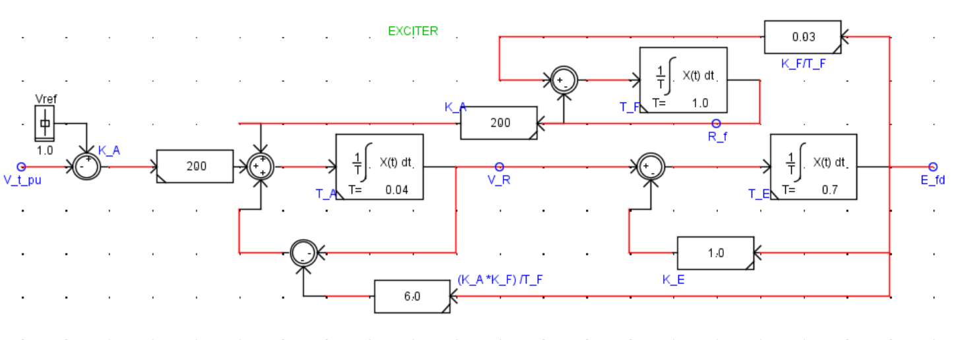
RTDS Exciter System
Excitation System
(Terminal Voltage Control)
Main Exciter
Stabilizing Transformer
Pilot Exciter

Slide 27
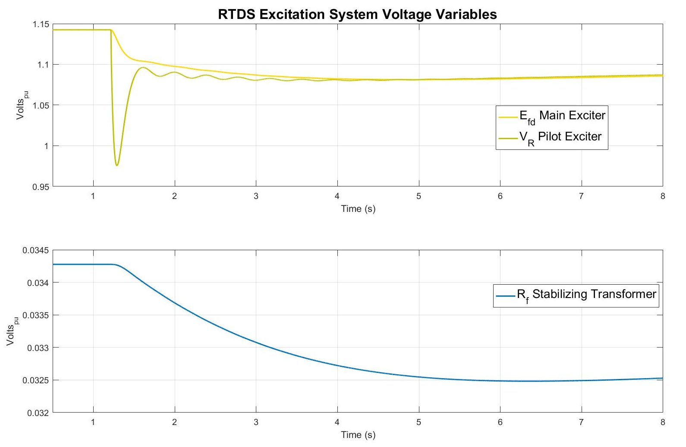
RTDS Excitation System Dynamic Response

Slide 28
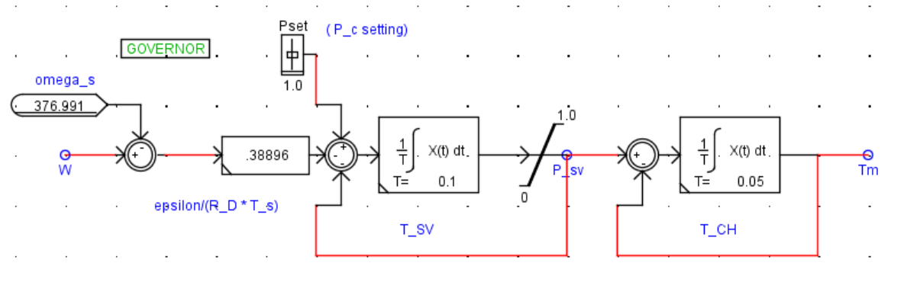
RTDS Governor System
Mechanical Power System
(Shaft Speed Control)
Single Stage Turbine Model
Governor Model
P_{SV} = Steam Valve Psn ( Pressure)
P_{C} = Power change setting
P_{C} = 0 when Open Ckt
R_{D} = Speed Droop Regulation Qty

Slide 29
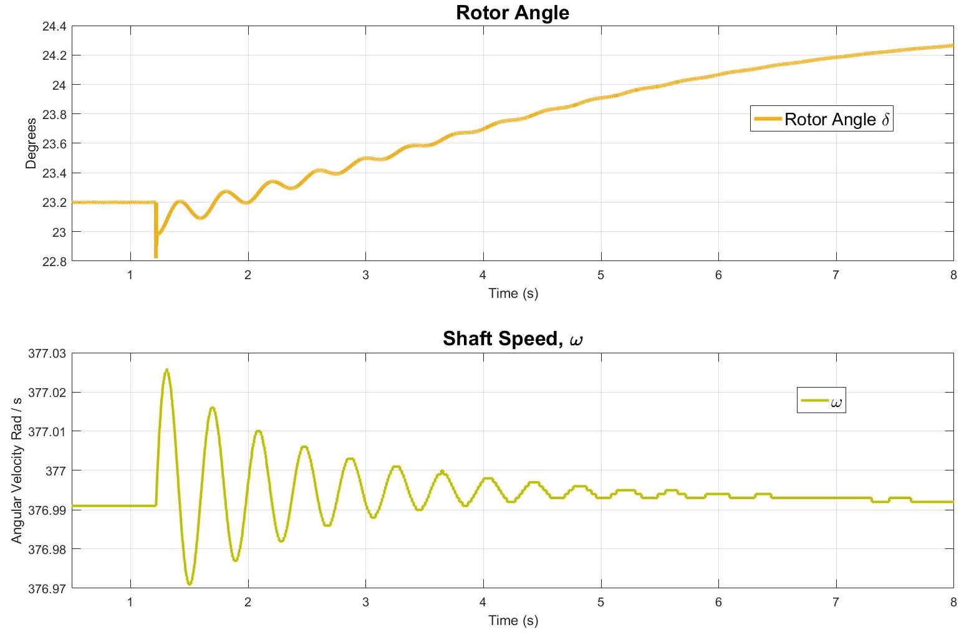
RTDS Mechanical Dynamic Response

Slide 30
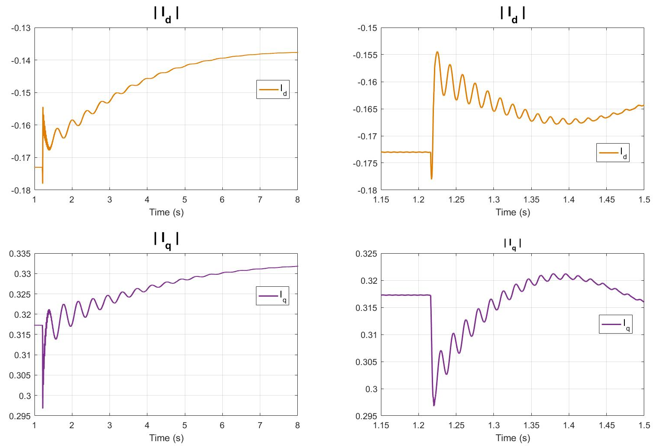
Terminal Current Dynamic Response

Slide 31
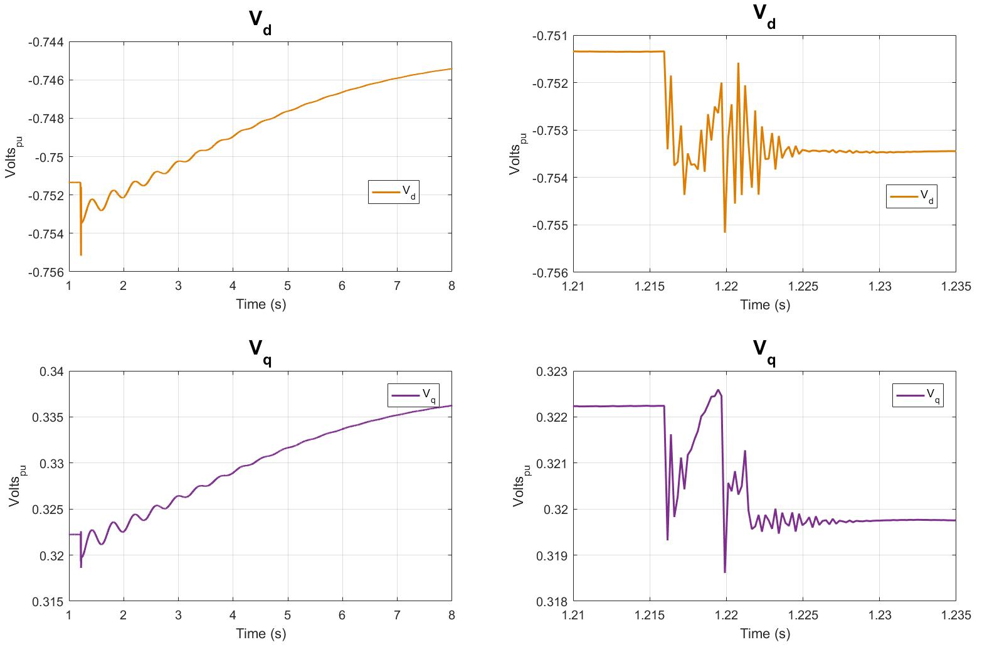
Terminal Voltage Dynamic Response – dqo

Slide 32

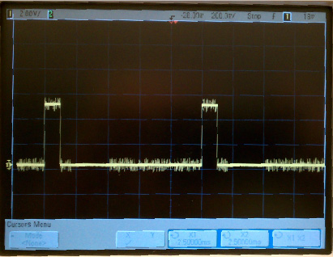
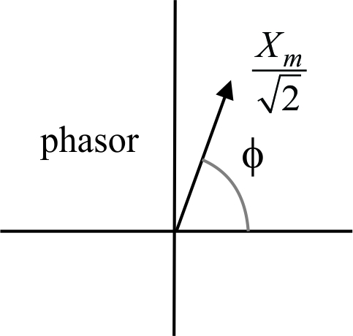
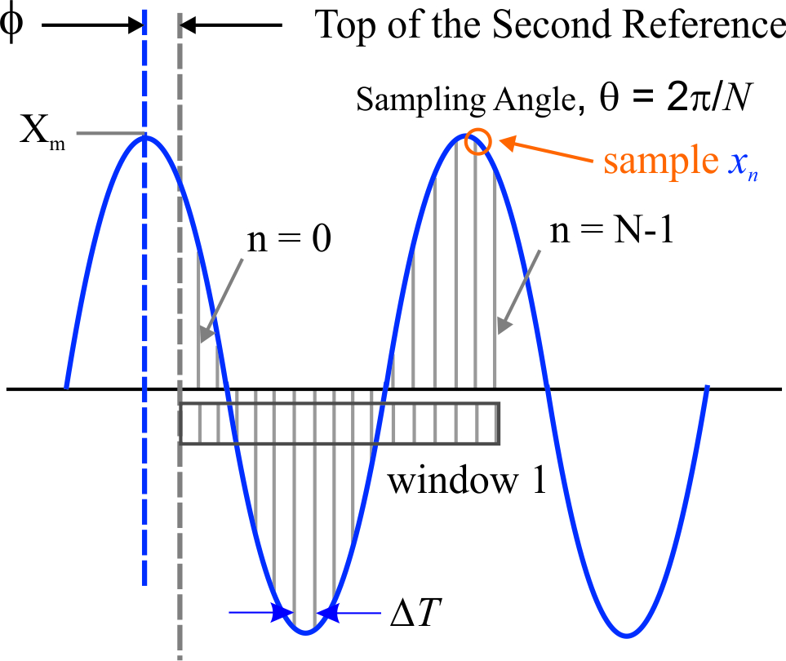
Synchrophasor Computation

Slide 33
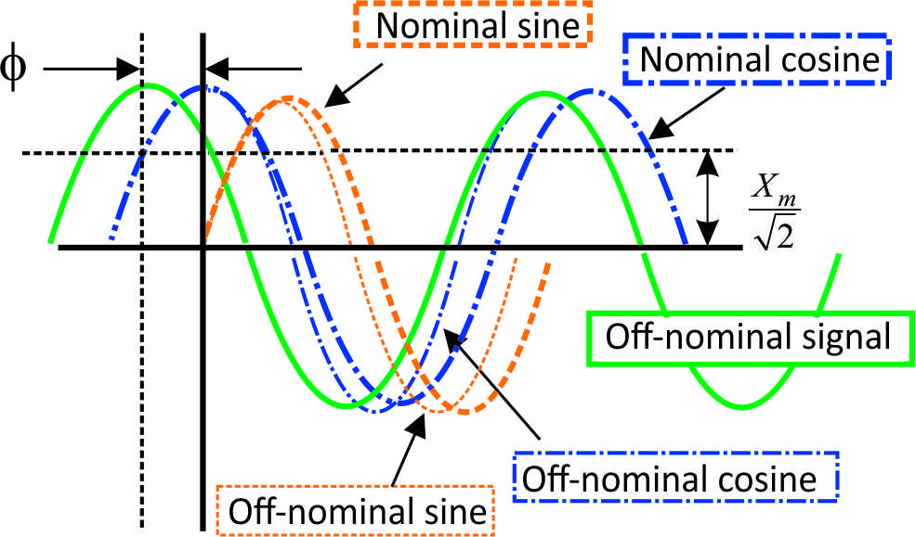
Synchrophasors Off Fundamental Frequency
Phadke, Arun G., and John Samuel Thorp. Synchronized phasor measurements and their applications. Springer Science & Business Media, 2008.
Measurement error due to
off-nominal frequency

Slide 34
Synchrophasor Measurement During a Disturbance
Phadke, Arun G., and John Samuel Thorp. Synchronized phasor measurements and their applications. Springer Science & Business Media, 2008.

Slide 35
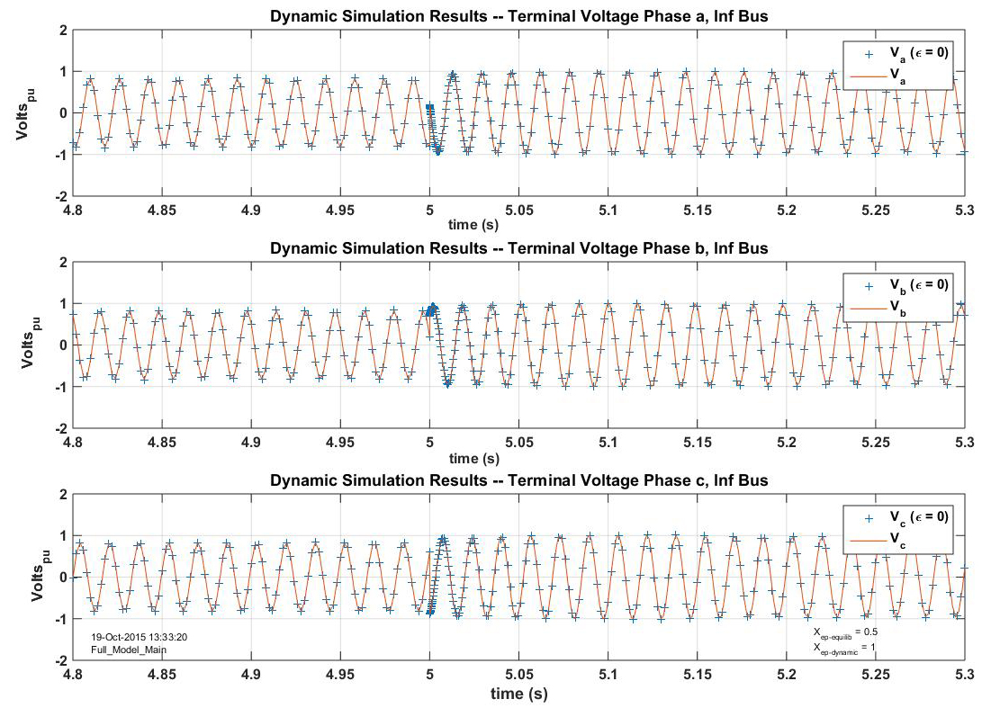
Terminal Voltage Dynamic Response – abc frame

Slide 36
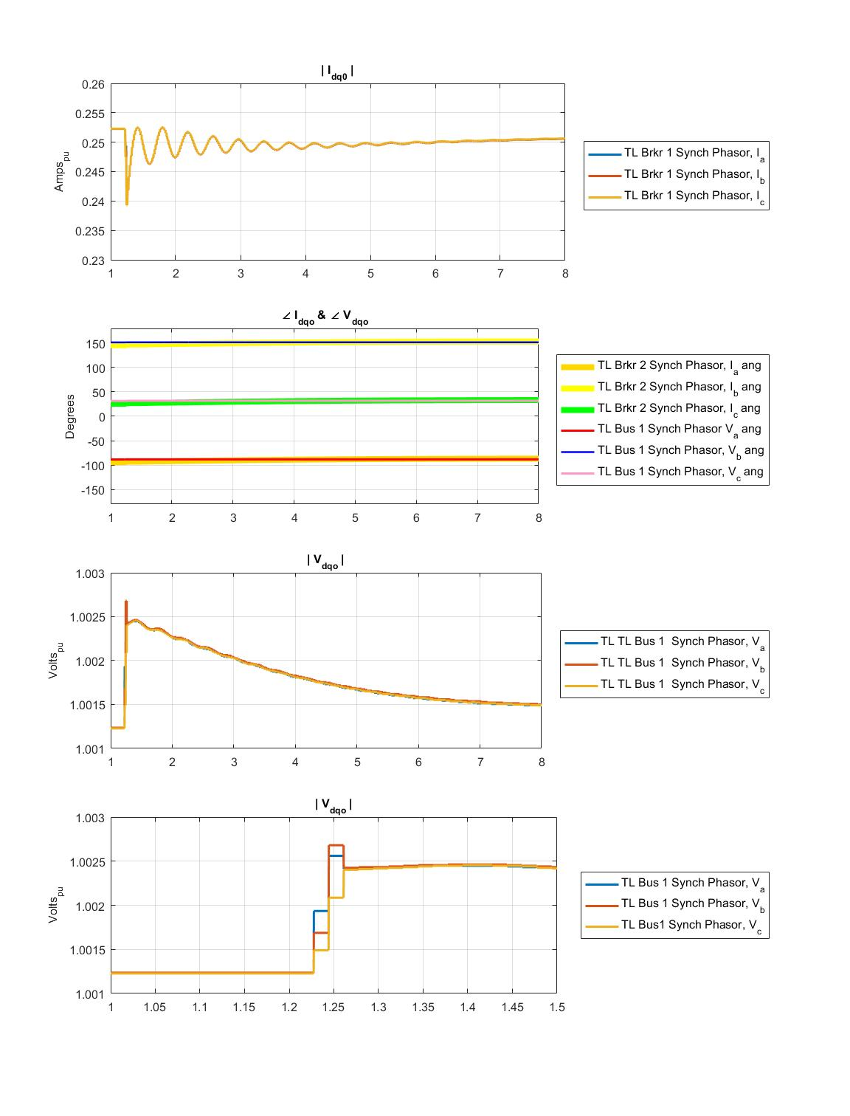
RTDS Synchrophasor Measurements

Slide 37
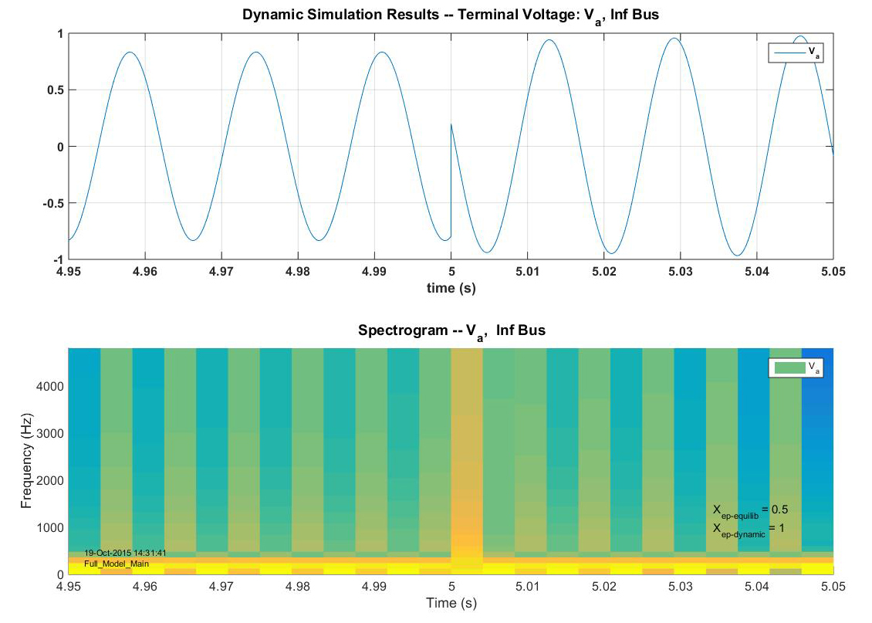
Terminal Voltage Dynamic Response

Slide 38
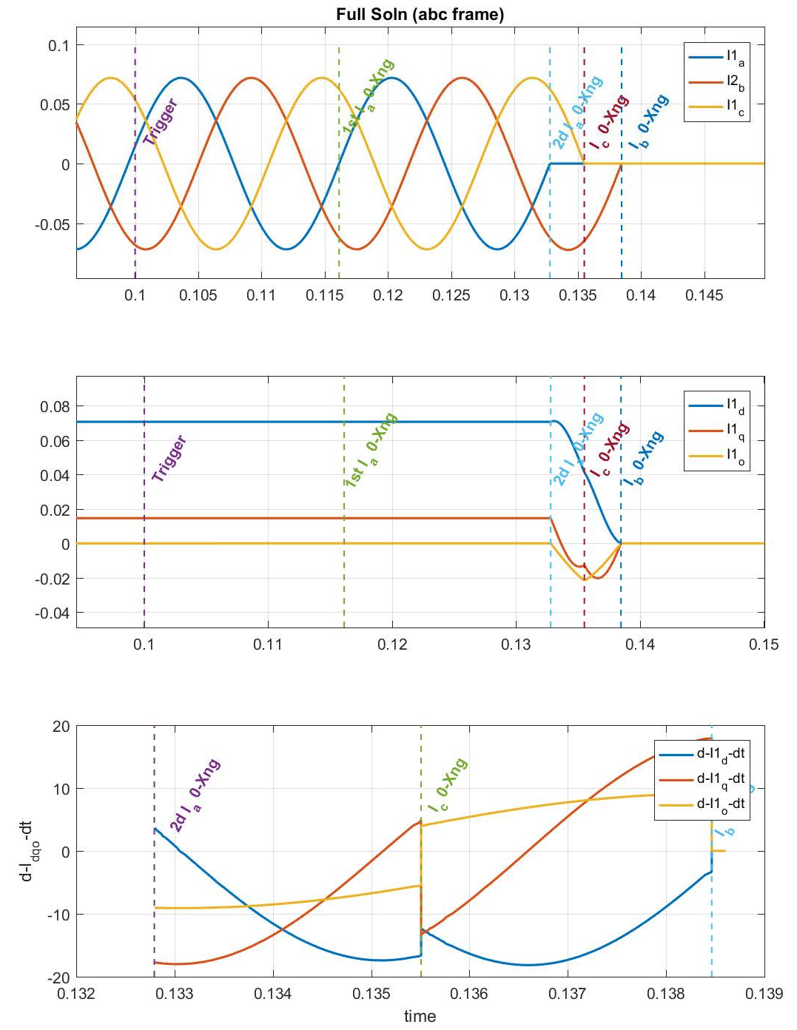
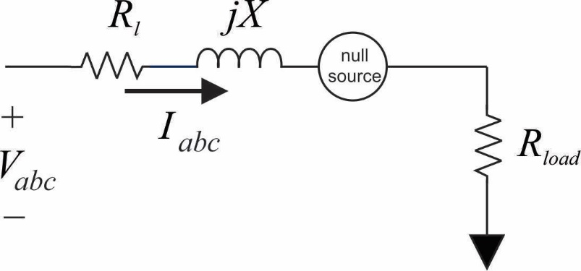
Breaker Opening – unbalanced 3 Phase – abc frame

Slide 39
Breaker Opening – unbalanced 3 Phase – dqo frame

Slide 40
Conclusions
“How does Synchrophasor data relate to the output of the dynamic model in simulation?”
As expected, Synchrophasor do discard most high frequency data
But dynamic phenomena is retained – in the transient stability region
Reduced order model (2 damper winding) has similar impact on data measurements…. The integral manifold is a filter.

Slide 41
QUESTIONS?
Karl Reinhard
reinhrd2@illinois.edu
reinhardke@gmail.com

Slide 42
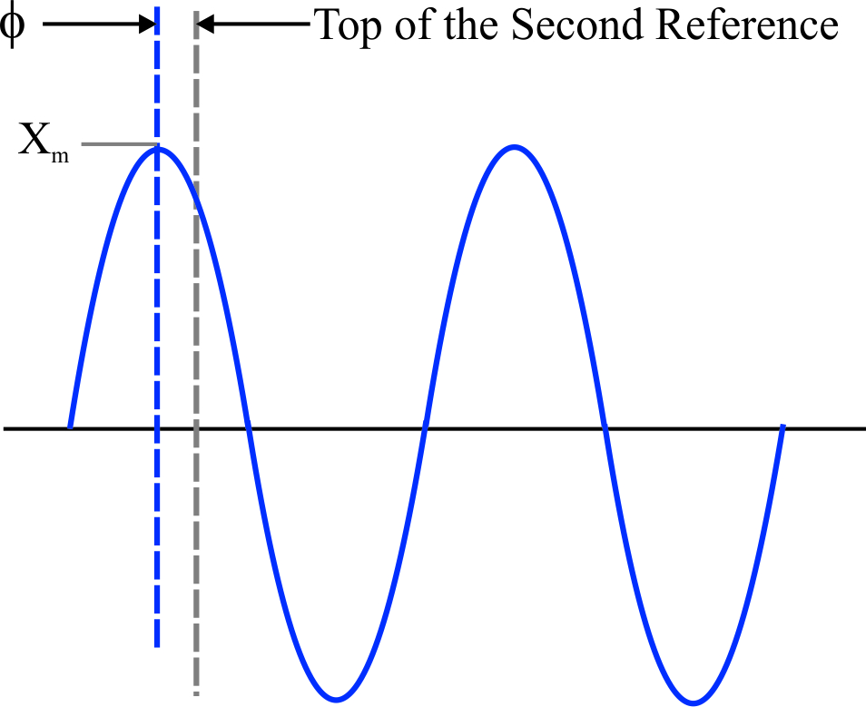

Synchrophasor Concept

